Slide 1
DEMO: How to set up and use AI agents to deduplicate data
Automating deduplication with AI—ensuring accuracy, consistency, and trust in every record

Slide 2



Session Goal
This session is part of a series of practical trainings on using AI Agents for data management.
Your CluedIn Trainer will demonstrate how to use the “Find duplicates” skill to identify and merge duplicates records.
We’ll begin with a simple example of deduplication in action and build toward more complex scenarios in upcoming sessions.
Note: This session is designed to develop practical experience with AI agents. For a full overview of AI agents, refer to the “CluedIn AI agents” session.

Slide 3


The data we’ll use
We are working with NorthStar Retail, a fictional international retailer. The challenge? The data contains duplicate customer records.
Customer data:
All records have a unique customer ID
Some of the records have identical emails or phone numbers

Slide 4
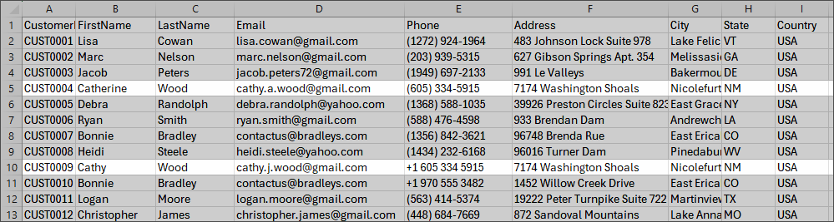

Slide 5
DEMO: How to set up and use AI agents to deduplicate data

Slide 6
Demo summary
You’ve seen how to:
Use AI agents to find duplicate records
Interpret results and act on them
Outcome:
You now understand how to leverage AI agents to effectively improve data quality at scale
Next step:
Pause the video and replicate the process.

Slide 7

Recommended materials
Before you get down to practice, make sure you are comfortable with data ingestion, mapping, and deduplication.
Ingest data | CluedIn Documentation
1.1. Ingestion | CluedIn Documentation
Deduplicate data | CluedIn Documentation

Slide 8
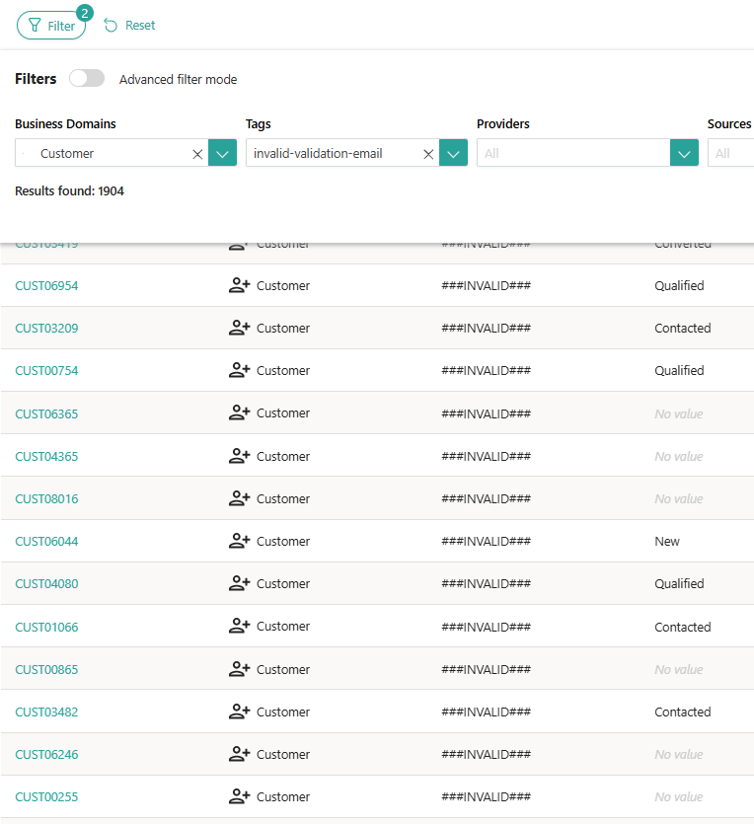


Learn more about AI agents in our documentation portal.
Next session: Using AI agents to suggest data quality rules.
What’s next?

